Slide 1
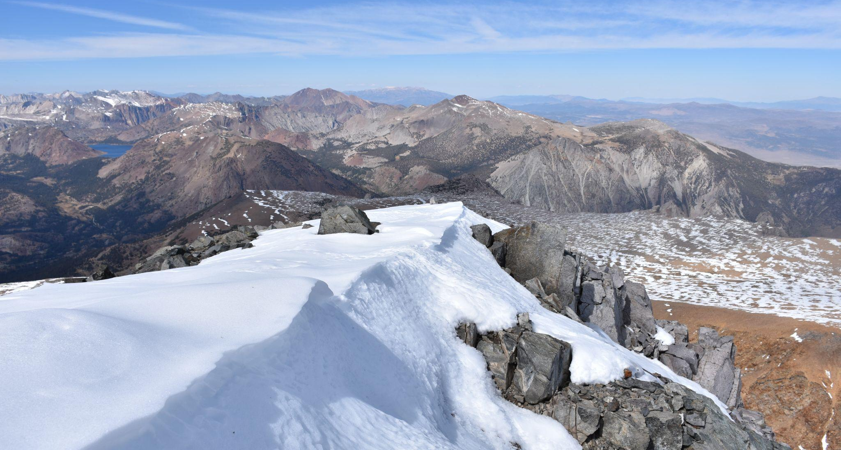
California Snowpack
Week 6 Updates
Malachy Moran, Kayla Wopschall, Derrick Hee, Tilman Bayer
Notes:
Photo: View from the top of Mount Dana, September 2017 (by Tilman)

Slide 2
Review of Project:
Predicting Water in the CA Central Valley
Stage 2: How much of that snow makes its way into the Central Valley water table?
Stage 1: How much snow falls in the Sierra Nevada?
Modeling Snow Water Equivalent (SWE)
SWE is the amount of water you would expect if you melted the snow present.
High variation of snow accumulation and complex weather, geologic, and climate related components.
Competition Segment
Each basin or melt water catchment has different factors that impact the amount of water that ultimately reaches it.
Snow Water Equivalent (SWE) from Part 1 input as max value for potential water gained from snow melt in the water table.
Notes:
Stage 1 modeling under competition by the US Bureau of Reclamation (on DrivenData.org)

Slide 3
Timeline & Progress
Convene with Experts & Literature Review
Identification of Data Sources
Definition of Testability Space
Model Draft
Final Model & Results
Final Project Write Up
Final Presentation
Capstone Showcase Deliverables
Sharing of Results with Professors
Stage 1
Stage 2
Project Wrap Up
Literature Review &
Meet With Experts
Initial Modeling:
MODIS, SNOTEL, CDEC data only
Third Model:
Addition of Sentinel 1, 2 Data, refinement of other metrics
Refinement of
Model for Sierras
EDA & Data
Wrangling
Second Model:
Adding Copernicus,
Improved Station Pairing
Competition Deadline
February 15th
TODAY

Slide 4
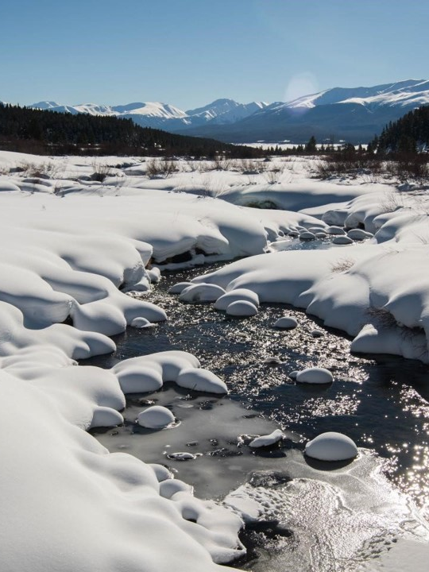
Additional Data Sources
Reworked Ground Station Data
Copernicus
Sentinel 1 & 2

Slide 5
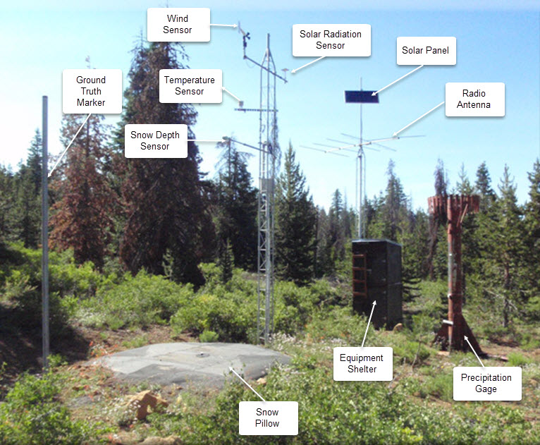
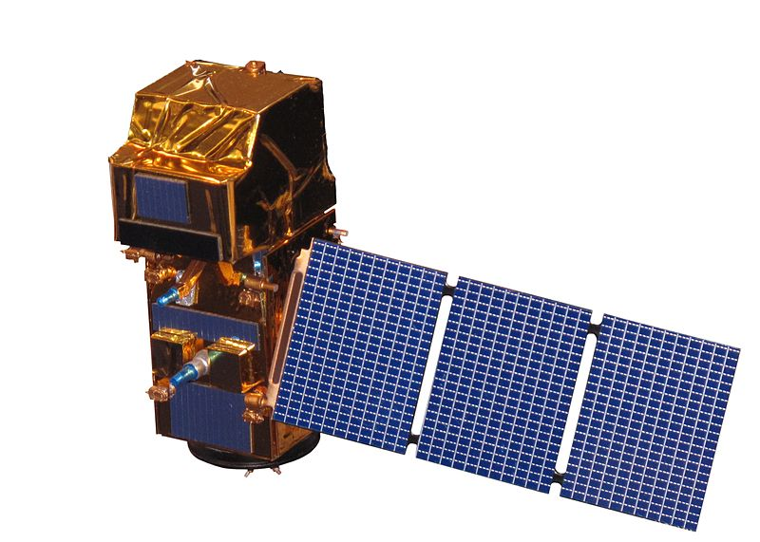
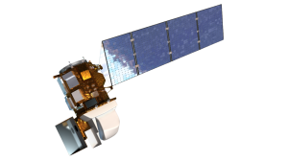
Dataset Review
Data sources for the competition:
SNOTEL/CDEC Stations ”Snow telemetry”: Automated measurements of SWE at isolated points/stations
MODIS ”Moderate Resolution Imaging Spectroradiometer” (Terra and Aqua satellites) Daily snow cover and albedo data
Sentinel 1* Synthetic Aperture Radar (SAR) satellite data, daily radar backscatter intensity
Sentinel 2 * Multi-spectral data with 13 bands in the visible, near infrared, and short wave infrared
Landsat 8 * Elevation data, extraction of slope and aspect
NOAA Weather * Localized weather inputs
Sentinel-2
Landsat-8
A Snotel station
*Data still in preparation and not included in initial model
Notes:
Image sources:
https://www.nrcs.usda.gov/wps/portal/wcc/home/aboutUs/monitoringPrograms/automatedSnowMonitoring/
https://commons.wikimedia.org/wiki/File:Sentinel_2-IMG_5873-white_(crop).jpg By Rama, CC BY-SA 2.0 fr
https://landsat.gsfc.nasa.gov/satellites/landsat-8/ USGS/NASA Landsat
Reference for data source descriptions: https://www.drivendata.org/competitions/86/competition-reclamation-snow-water-dev/page/417/#features

Slide 6
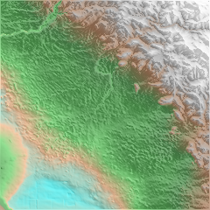
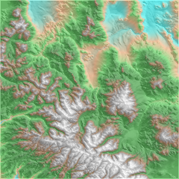
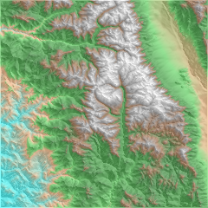
Copernicus DEM Satellite Imagery
The Copernicus DEM 90 is a digital surface model with a 90 meter resolution.
Primary information we gain from Copernicus:
Elevation (coded in the color of the pixel)
“hillshade”, a function of aspect (the compass direction toward which the surface points at the location)
2 step process:
Pull in the Copernicus image that contains the centerpoint of the area of interest
Trim image to within .05 degrees of latitude and longitude (roughly a 5 mile square)
Result scaled up to 224x224 for image model processing

Slide 7
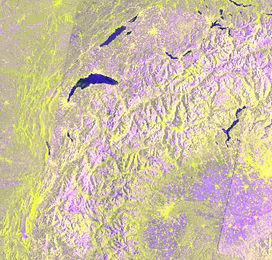
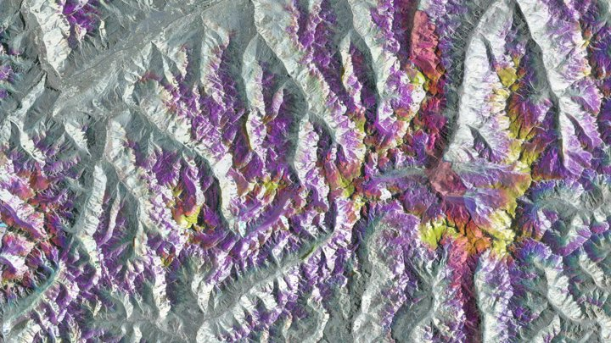
Sentinel 1- SAR
Collects Synthetic Aperture Radar - SAR
Part of the Copernicus Program
Ground Range Detected (GRD) Level 1 data used in our model.
Sentinel 1A
Sentinel 1B
Bands of Interest and what they do:
VH Band - vertical horizon
VV Band - vertical vertical
Cross polarization ratio - ratio of VH to VV polarization backscatter
Detects Wet and Dry Snow conditions
Notes:
Image source: https://developers.google.com/earth-engine/datasets/catalog/COPERNICUS_S1_GRD

Slide 8
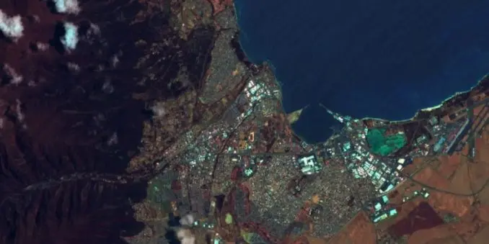
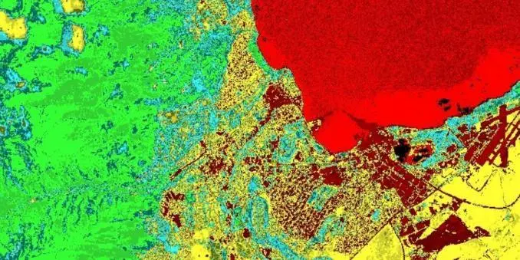
Sentinel 2
Geology (B12, B11, B2)
Satellite that collects information on:
Ultra blue (Aerosol and Coastal Information)
Visible and Near Infrared
Short Wave Infrared
Resolution between 10-60m
Combinations of Bands used to highlight different features of the physical space being imaged.
Combinations we’re including are focused on identifying Geology and Vegetation
Geology identifies:
Faults, rock types (lithology), and geologic features
Vegetation Index identifies:
Amount of vegetation and urban water features
Vegetation Index (B8-B4)/(B8+B4)
Notes:
Image sources https://gisgeography.com/sentinel-2-bands-combinations/

Slide 9
Modeling Advances
Outcomes

Slide 10
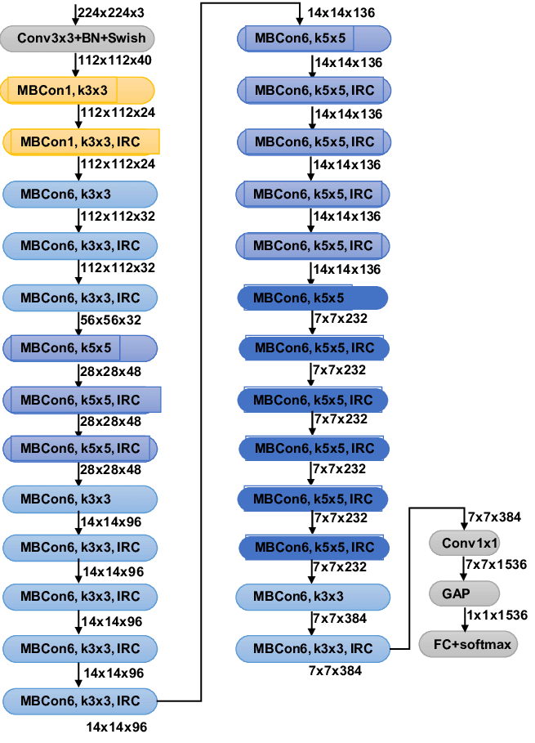
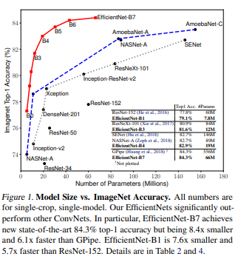
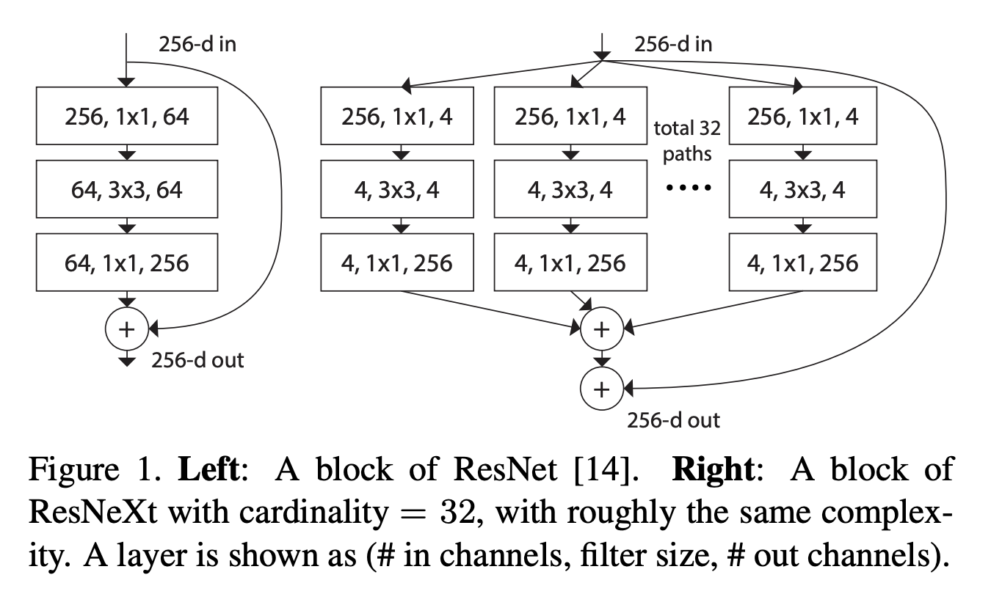
CNN Architecture comparison
ResNeXt
EfficientNetB3
Repetition of a building block
"split-transform-merge" strategy (branched paths within a single module)
Aggregates a set of transformations
Exposes Cardinality (size of transformation sets) as a factor
CNN built with efficiency and accuracy in mind
Smaller number of parameters (faster training) while maintaining comparable accuracy seen in other top class model architectures.
Notes:
Efficientnet paper - https://arxiv.org/pdf/1905.11946.pdf
ResNeXt paper - https://arxiv.org/abs/1611.05431v2
Our network is constructed by repeating a building block that aggregates a set of transformations with the same topology. Our simple design results in a homogeneous, multi-branch architecture that has only a few hyper-parameters to set. This strategy exposes a new dimension, which we call "cardinality" (the size of the set of transformations), as an essential factor in addition to the dimensions of depth and width.

Slide 11
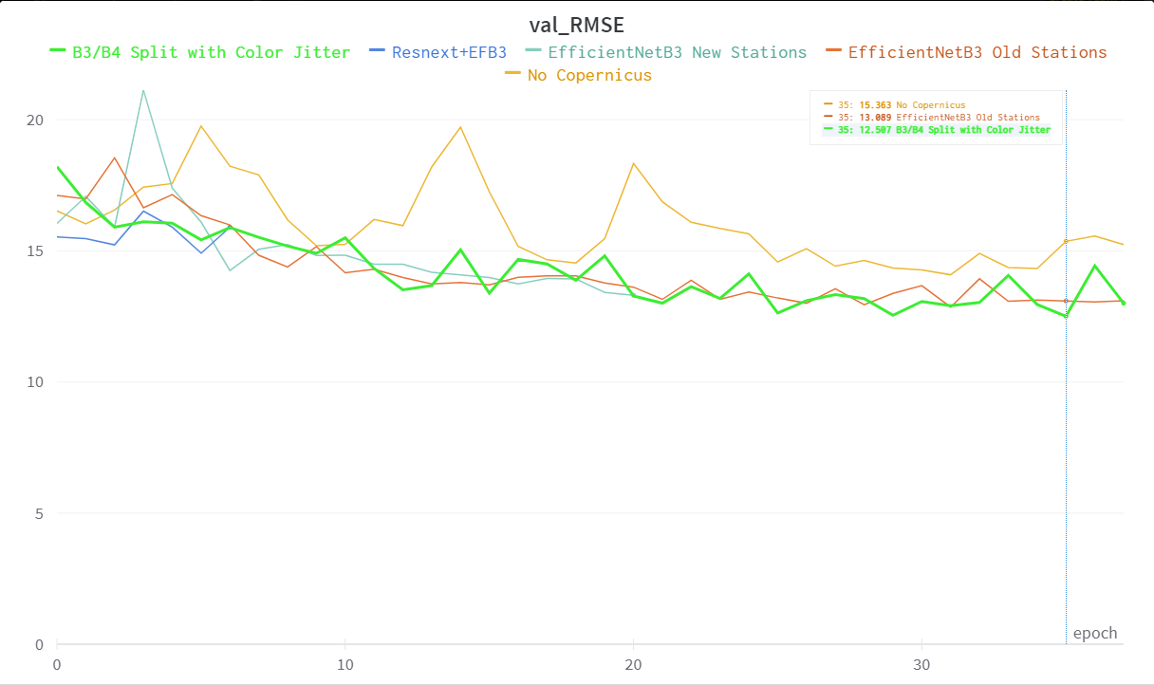
Modeling Outcomes - Architecture and Data Changes
Adding Copernicus data showed a marked improvement
Changing the method of computing nearby station SWE showed a small improvement.
Using a more powerful model on the Copernicus data showed moderate improvement
ResNext performed best but was not computationally feasible

Slide 12
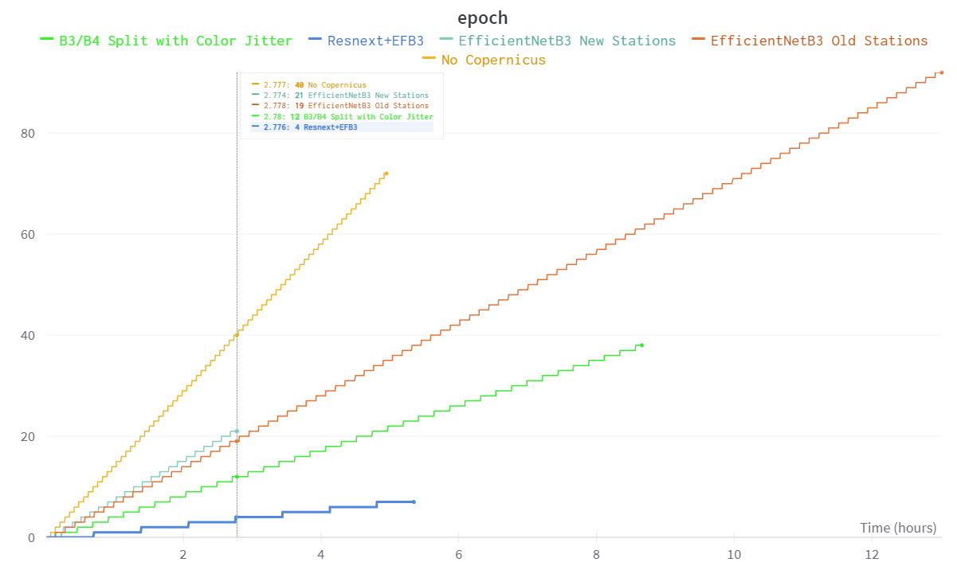
Modeling Outcomes - Training Time Issues
Adding the Copernicus data greatly slowed down the processing
While ResNext performed best, it was much slower.
Changing the Copernicus Model to EfficientNet B4 seems like a useful middle ground

Slide 13
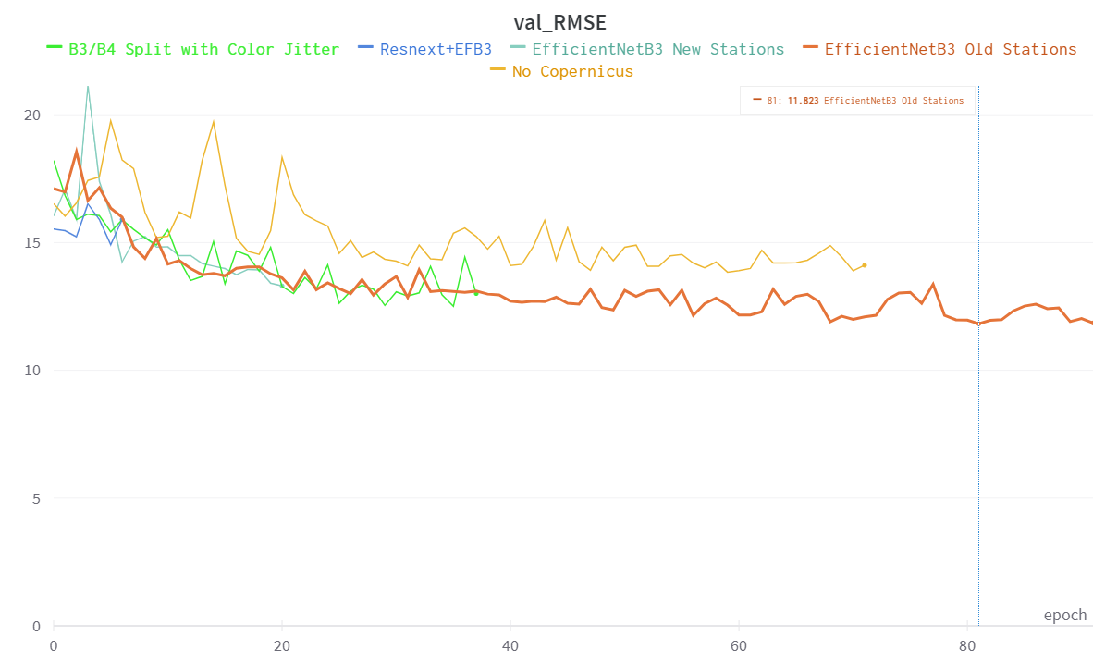
Training Time Trumps Model Power
Our Best RMSE for this week was 11.82 inches
Baseline last week was 14.58 inches
This was achieved in epoch 81 of the EfficientNetB3 model with the old station computations
Took approximately 12 hours to reach
One of our next steps will be to move from Google Colab to AWS and train for a longer period

Slide 14
The Next Week…
Finish incorporating data sources for Stage 1 Modeling
Package and deliver model weights to Competition February 15th
Reconnect with Professors to discuss early results and prep for Stage 2

Slide 15
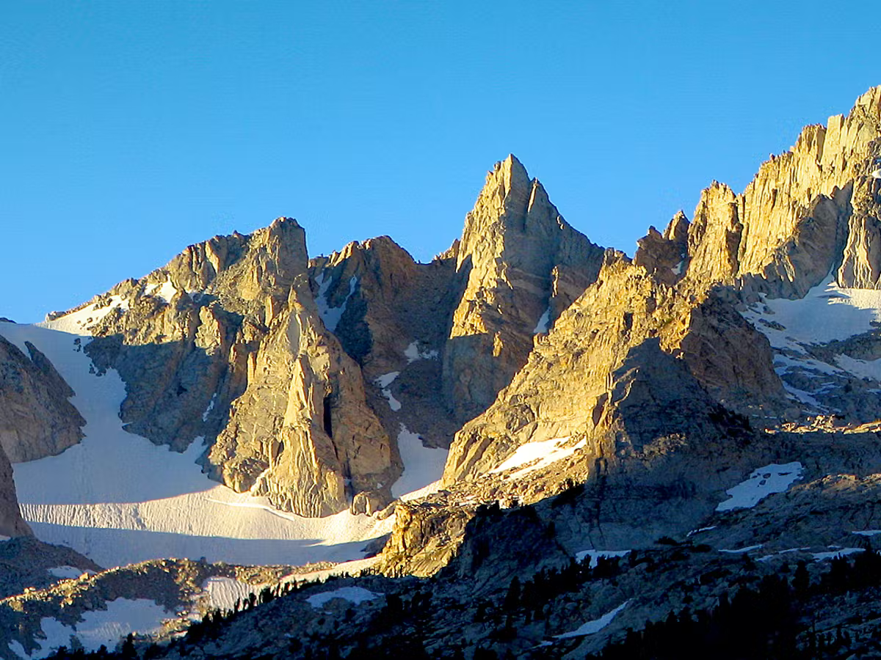
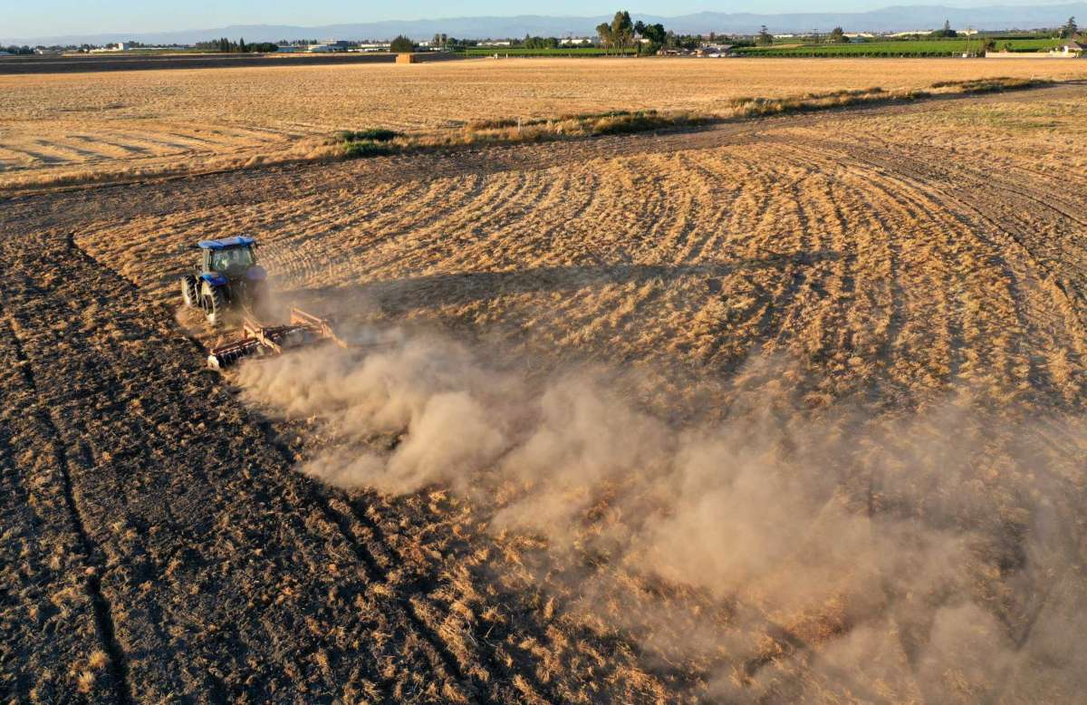
California Snowpack and Agricultural Water Supply
As much as 70% of agricultural water in California’s Central Valley estimated to come from the Sierra Nevada mountains.
CA crops account for 13% of ALL US crops.
Billion dollar industry with estimated 800,000 workers.
How much water do we get to use?
Notes:
Snowpack serves as a vital annual water storage system. Snow is stored during the winter months and slowly melts out, providing essential hydration to high altitude flora as well as refueling groundwater.
With the increasing temperatures due to climate change, we are seeing a disruption of this natural cycle.
Not only is the snowmelt peak getting hit earlier (~March instead of April), we are seeing more extreme weather in all regions, causing more uncertainty for regions that depend on SWE as a resource.
Being able to estimate the SWE will provide water managers with information to plan out the coming year.

Slide 16
Stage 1
Modeling SWE
Challenges, Modeling Approach
Data & Preliminary Results

Slide 17
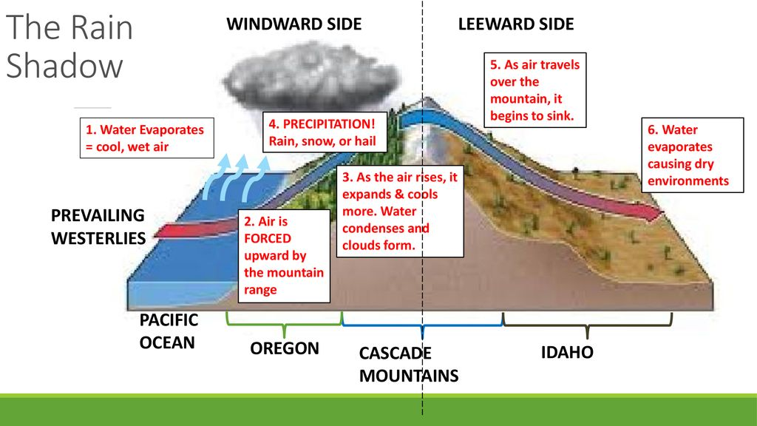
Challenges with Modeling Snow Water Equivalent
Snow accumulation is a complex and highly variable process, making it difficult to predict.
Key variables that determine SWE:
Local weather (wind, water vapor, temperature)
Elevation, slope and aspect of surface
Ground cover and vegetation
Large scale geomorphology impacts (e.g. rain shadows)
Notes:
There is a marked difference in precipitation due to mountains
As clouds are forced over mountains, they release their payload in the form of precipitation. As a result, there is a noticeable decrease on the opposite side of the mountain

Slide 18
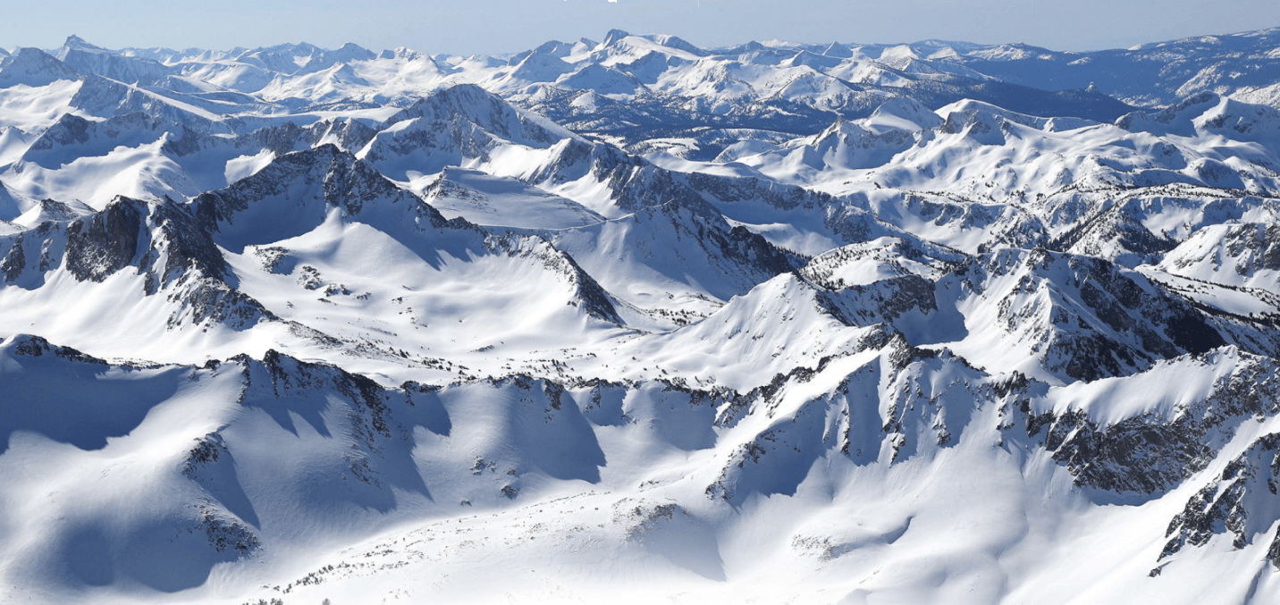
Sierra Nevadas Complexity of Peaks
Highly complex localized patterns - making estimates of SWE extremely difficult.

Slide 19


Approach
“Snowcast Showdown” Competition
Use machine learning for weekly near-realtime SWE predictions at the 1km x 1km scale for three Western US areas of interest (Olympic Peninsula, Sierra Nevadas, Rockies)
Competition hosted by the United States Bureau of Reclamation (on Driven Data)
February 15th model submission due date
Evaluated on live data until July 1
Notes:
Be clear on what we are predicting at what cadence.
$500k prize money, over 800 contestants already, we’re entering late USBR is a federal agency which oversees water resource management,

Slide 20
Stage 1
Data &
Preliminary Results
Data Sources and Prep
Data pipeline diagram
Results of early modeling

Slide 21
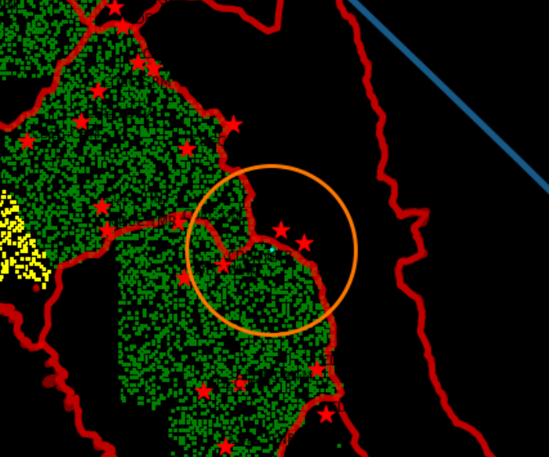
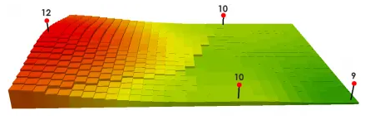
SNOTEL/CDEC Station Data
SNOTEL stations, located throughout the US, get accurate real time measurements of SWE
SNOTEL stations are sparse, at accessible locations, and not adequate for capturing the complexity needed to estimate SWE for entire regions.
Station data and SWE used as model input
SNOTEL stations “paired” with study areas
Want only station readings that are relevant to area of interest.
Need to take into account geomorphology
Paired using K-Nearest-Neighbors approach
Inverse Distance Weighting
https://gisgeography.com/inverse-distance-weighting-idw-interpolation/
Notes:
Essentially taking a K-Nearest-Neighbors approach
We are interested in stations that are close to the sample point as they will be most representative of the actual SWE
We are planning on weighing the measured SWE from each station with Inverse Distance Weighting
The closer the station is, the more influential it will be on the SWE estimate
This will also provide some variation in the samples, otherwise each cluster of sampling spots will have the exact same estimated SWE
Taking from multiple stations also addresses some NaN measurements seen in EDA

Slide 22
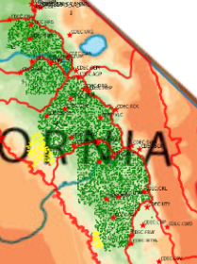
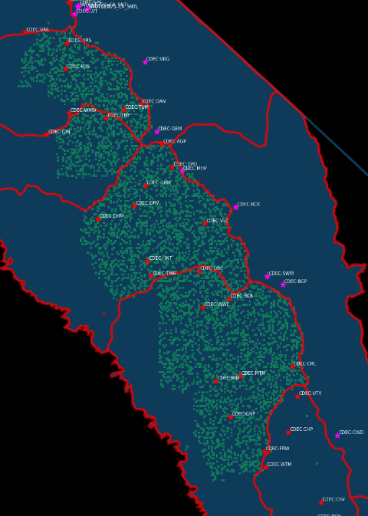
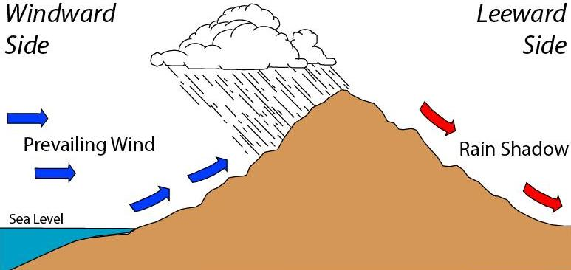
SNOTEL/CDEC Station Data - Accounting for Geo
Geomorphology plays a big role in snow fall.
Data from the nearest station may not reflect the same environment.
Example: Strong rainshadow effect in the Sierra Nevadas
Meg Stewart - https://www.flickr.com/photos/megstewart/8644087724/
Notes:
There is a marked difference in precipitation due to mountains
As clouds are forced over mountains, they release their payload in the form of precipitation. As a result, there is a noticeable decrease on the opposite side of the mountain
Some stations are expected to fall in the rainshadow
As a result, their measurements might not be reflective of what we actually will observe in a nearby sample on the opposite side

Slide 23


SNOTEL/CDEC Station Data - Trickier NaNs
There is a number of missing values in the dataset
Some Stations have no values on particular days
some cells have nearby stations that did not record SWE.
further away the station is, the less meaningful the SWE estimate is
Some days have no results from any station
missing values when joining against cells for those particular days
Possible solutions:
Fill in missing values with historical data
Interpolate with known past and future data
Utilize meteorological data to fill in blanks

Slide 24





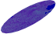
MODIS Data - Satellite Imagery
MODIS (Moderate Resolution Imaging Spectroradiometer) instruments aboard the Terra and Aqua Satellites.
Daily Snow Cover dataset from Google Earth engine. It has three bands, mapped to the Red, Green, and Blue values for the images
Red: Snow Cover
Green: Snow Albedo (Reflectance)
Blue: Normalized Difference Snow Index (NDSI)
This is the raw data, which is why the images are so blue
MODIS is filtered to only images on or before the date the label was collected. Then the most recent image is taken
We are currently using a 10KM circle around the centerpoint of the prediction area
Notes:
“The MODIS Snow Cover Daily Global 500m product contains snow cover, snow albedo, fractional snow cover, and quality assessment (QA) data. Snow cover data are based on a snow mapping algorithm that employs a Normalized Difference Snow Index (NDSI) and other criteria tests.” https://developers.google.com/earth-engine/datasets/catalog/MODIS_006_MYD10A1?hl=en#description

Slide 25
Example Data Pipeline and Model Architecture
Training Labels
Pytorch Lightning
Training DataFrame
Ground Station Data
MODIS
Image Model
OTHER
Image Models
Training DataFrame
Additional Data
MODIS
Images
OTHER Images
Feature Extraction
Training DataFrame
Paths To Imagery
Linear Layers
Prediction
Tabular Data
Image Data
Modelling
Notes:
Mal: Our data essentially comes in two forms, tabular and imagery. We will build the training dataframe starting from the training labels. Tabular data such as wind speeds, nearby location SWE measurements, or precipitation will be added row wise by location and date.
Imagery will be downloaded locally, and the paths to those images will be added as another column to the training dataframe.
Our model will be built in two “stages” on a Pytorch Lightning Backbone. The first stage of the model will be image modeling, using an architecture such as EfficientNet. There will be one model for each image source.
Rather than having a classification head, we will use feature extraction to pull all of the parameters from the final layer of the model. The features will be concatenated together, along with the tabular data, and fed into the linear fully connected layers that output a prediction.

Slide 26
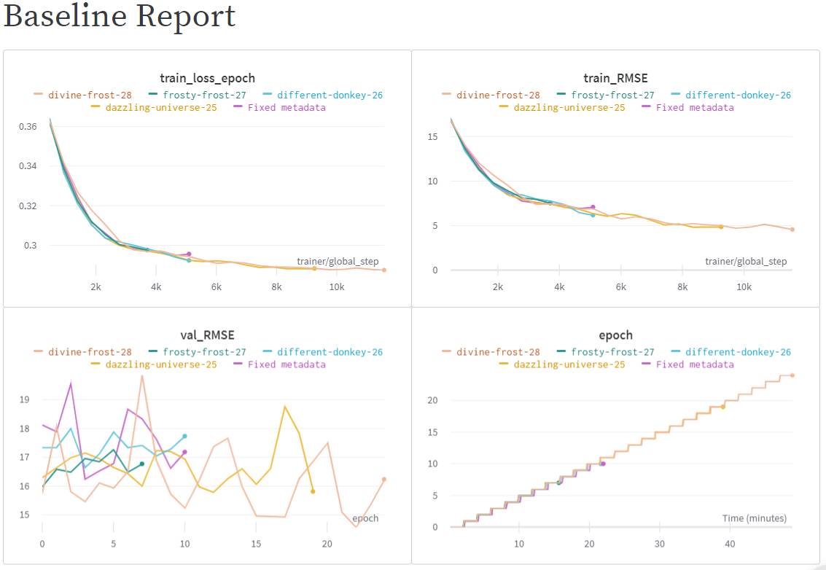
EfficientNet B1 Pruned
A very simple baseline model was fit to only the MODIS images.
Region was limited to the Sierra Nevadas to limit Model size
EfficientNet B1 Pruned was chosen for speed of training (~2.5 mins per Epoch)
A Stratified K-Fold was used on binned SWE data with 5 folds
RESULTS (in RMSE):
Best Model: 14.58 inches
Worst Model: 16.65 inches
SWE Standard Deviation: 19.82 inches
Competition best: ~3.5 inches
Notes:
Once we had our first set of image data (MODIS), a very basic first pass model was fit to establish a baseline. In order to speed production and testing, the sample was limited to only the Sierra Nevadas. Likewise, EfficientNet B1 Pruned was chosen for its light weight and speed of training. No transformations were used outside of resizing and Normalization of the images. The training set was stratified by the SWE, and 5 K-folds were used to give a clearer picture of our model performance. Essentially this takes all the training data, cuts it up into 5 separate training/validation splits, and fits a separate model to each split (while attempting to keep the proportion of high/low SWEs the same in each split) This first pass model achieved a Root Mean Squared Error range of about 16 to 16.8. The standard deviation of the SWE variable provides a good measuring stick, as this is the RMSE we would expect if we just guessed the Mean SWE value for every prediction. Getting lower than that means you are doing better than a blind guess. The standard deviation of the SWE variable is around 19.8 We have improved over this metric, but we still have a long way to go to beat the competition best with an RMSE of about 3.5

Slide 27
Stage 2
Modeling
Ground Water
Considerations for Modeling
Brief Overview of Approach

Slide 28
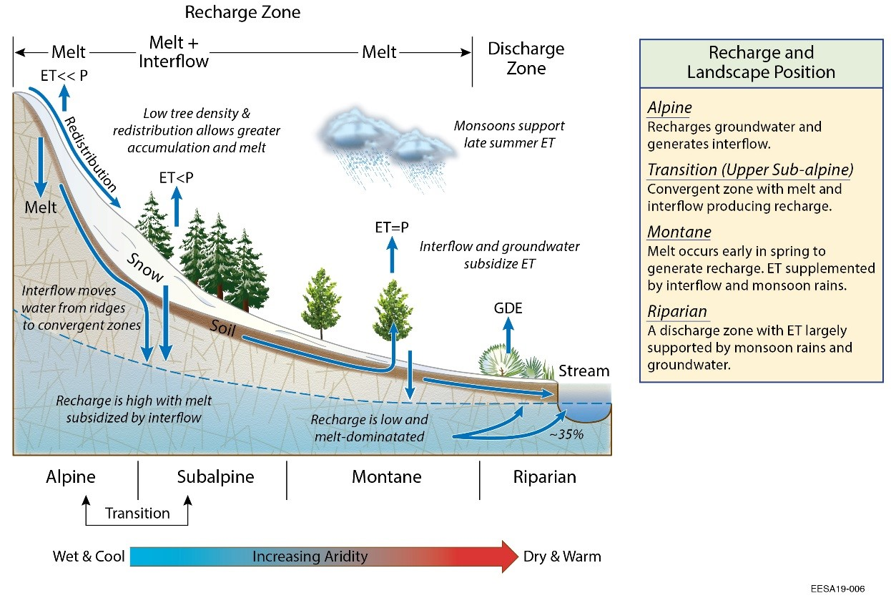
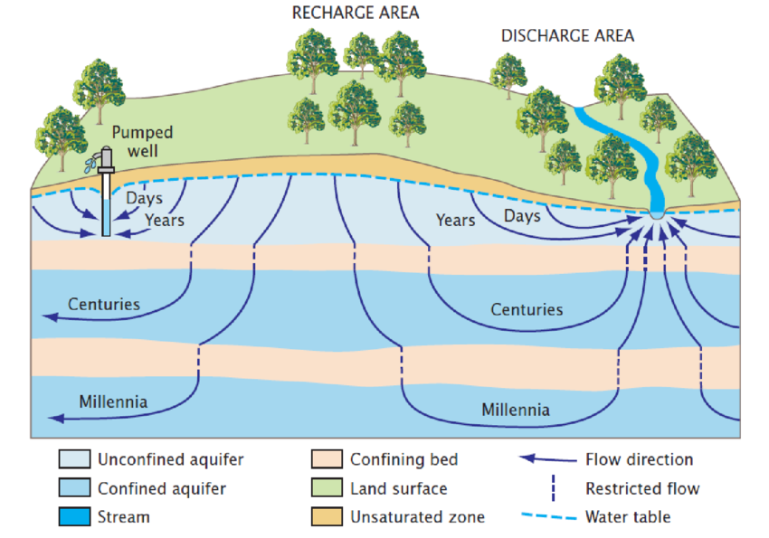
Upcoming: Modeling Groundwater from Snow
Groundwater Modeling is highly complex on its own.
Highly dependent on Natural structures (geology, permeability of sediments, drainage basin shape, natural disruptions) and Anthropogenic impacts (dams, subsurface structures, diversion of drainage, removal/use of water)

Slide 29
Overview of Approach
Leverage as many existing water table models as possible
Utilize our SWE predictions for a more nuanced estimate
Creation of a forecasting tool that incorporates mins and maxs with buffers and regions for error.
End Product: Usable dashboard with weekly updating
** Stage 2 is still conceptual and will take shape as we transition from Stage 1

Slide 30
Next Steps

Slide 31
Next Steps
Stage 1:
Finish the data staging/prep and incorporate additional data sources to model.
Refine model parameters.
Refine calculated inputs
Station weights
Raw data vs. change detection in satellite bands
Adjustments for appropriate weather metrics
Prepare for competition submission
Stage 2:
Scope and Begin

Slide 32
Questions?
Thank you!

Slide 33
References
Ahamed, Aakash, et al. “Assessing the Utility of Remote Sensing Data to Accurately Estimate Changes in Groundwater Storage.” Science of The Total Environment, vol. 807, Feb. 2022, p. 150635. ScienceDirect, https://doi.org/10.1016/j.scitotenv.2021.150635 .
Aschauer, Johannes, and Christoph Marty. “Evaluating Methods for Reconstructing Large Gaps in Historic Snow Depth Time Series.” Geoscientific Instrumentation, Methods and Data Systems, vol. 10, no. 2, Nov. 2021, pp. 297–312. gi.copernicus.org, https://doi.org/10.5194/gi-10-297-2021 .
Huning, Laurie S., and Steven A. Margulis. “Investigating the Variability of High-Elevation Seasonal Orographic Snowfall Enhancement and Its Drivers across Sierra Nevada, California.” Journal of Hydrometeorology, vol. 19, no. 1, Jan. 2018, pp. 47–67. journals.ametsoc.org, https://doi.org/10.1175/JHM-D-16-0254.1
Huning, Laurie S., et al. “Implications of Detection Methods on Characterizing Atmospheric River Contribution to Seasonal Snowfall Across Sierra Nevada, USA.” Geophysical Research Letters, vol. 44, no. 20, 2017, p. 10,445-10,453. Wiley Online Library, https://doi.org/10.1002/2017GL075201
Margulis, S. A., Cortés, G., Girotto, M., & Durand, M. (2016). A Landsat-Era Sierra Nevada Snow Reanalysis (1985–2015), Journal of Hydrometeorology, 17(4), 1203-1221. Retrieved Feb 2, 2022, from https://journals.ametsoc.org/view/journals/hydr/17/4/jhm-d-15-0177_1.xml

Slide 34
Image Sources
Slide 1: View from the top of Mount Dana, September 2017 (by Tilman)
Slide 2: CA Central Valley Farming: https://s.hdnux.com/photos/01/20/74/61/21220451/3/1200x0.jpg
Sierra Nevada Peaks: https://images.theconversation.com/files/412186/original/file-20210720-17-l3bga2.jpg?ixlib=rb-1.1.0&q=45&auto=format&w=1200&h=900.0&fit=crop
Slide 5: Rain shadow diagram: https://slideplayer.com/slide/13862119/85/images/5/The+Rain+Shadow+WINDWARD+SIDE+LEEWARD+SIDE+PREVAILING+WESTERLIES.jpg
Slide 6: Sierra Nevadas Pano of multiple peaks: https://snowbrains.com/wp-content/uploads/2017/04/Screen-Shot-2017-04-13-at-7.55.59-AM-min-1.png
Slide 9: https://www.nrcs.usda.gov/wps/portal/wcc/home/aboutUs/monitoringPrograms/automatedSnowMonitoring/
https://commons.wikimedia.org/wiki/File:Sentinel_2-IMG_5873-white_(crop).jpg By Rama, CC BY-SA 2.0 fr
https://landsat.gsfc.nasa.gov/satellites/landsat-8/ USGS/NASA Landsat
Slide 11: https://www.flickr.com/photos/megstewart/86440877https://www.flickr.com/photos/megstewart/8644087724/
Slide 18: https://www.researchgate.net/profile/Dirk-Mallants/publication/302559179/figure/fig6/AS:359982580158466@1462837943349/dealised-cross-section-showing-groundwater-flow-paths-from-recharge-to-discharge-areas.png

